Slide 1


Build a Modern Digital Workplace with Office 365
- Ragav Jagannathan, KLST

Slide 2
About Me

Slide 3
About Me
My name is Ragav Jagannathan (“Ragav”)
Born in India, Raised in Australia, Living in New Jersey and Working in New York City. Travelled over 4 continents, 22 countries, 58 cities for SharePoint implementations.
15+ years experience with SharePoint, 106+ Enterprise SharePoint implementations.
SharePoint advocate, mentor, blogger, trainer, evangelist.
Solve Complex Business problems using code-free, out-of-box SharePoint.
Founder & President - KL Software Technologies (KLST) group of companies – www.klstinc.com
Follow me @
  Twitter - @ragavj
  Skype – sip:ragav@klstinc.com
  LinkedIn – www.linkedin.com/in/ragav
  Blog – ragavj.blogspot.com

Slide 4
About KL Software Technologies (“KLST”)

Slide 5
About KL Software Technologies (“KLST”)
14+ Years of Excellence
HQ in New York City, offices in Sydney AUSTRALIA and Chennai INDIA.
Microsoft GOLD Competencies in Cloud Productivity, Cloud Platform, Collaboration, Application Development
Global Microsoft Certified Team of SharePoint experts
Key Partnerships – Microsoft, Apple, Google, Harmon.ie, Metalogix
Mobile-First, Cloud-First Software+Services offerings – lead with key vertical & horizontal solutions – www.klstinc.com/whyklst
Project101 - Mobile-First Project & Portfolio Management for Office 365 – www.klstinc.com/project101
ConnectORG - Simplified Enterprise Social Knowledge Management – www.klstinc.com/connectorg

Slide 6
Session Objectives

Slide 7



Session Objectives
1
2
3
Collaboration Today
Modern Tools
What, When, How

Slide 8
Collaboration Today

Slide 9
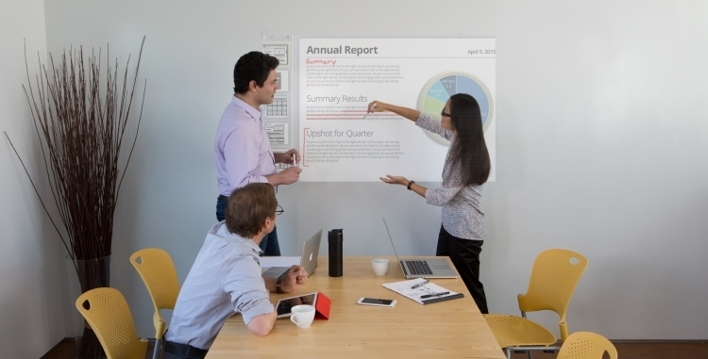
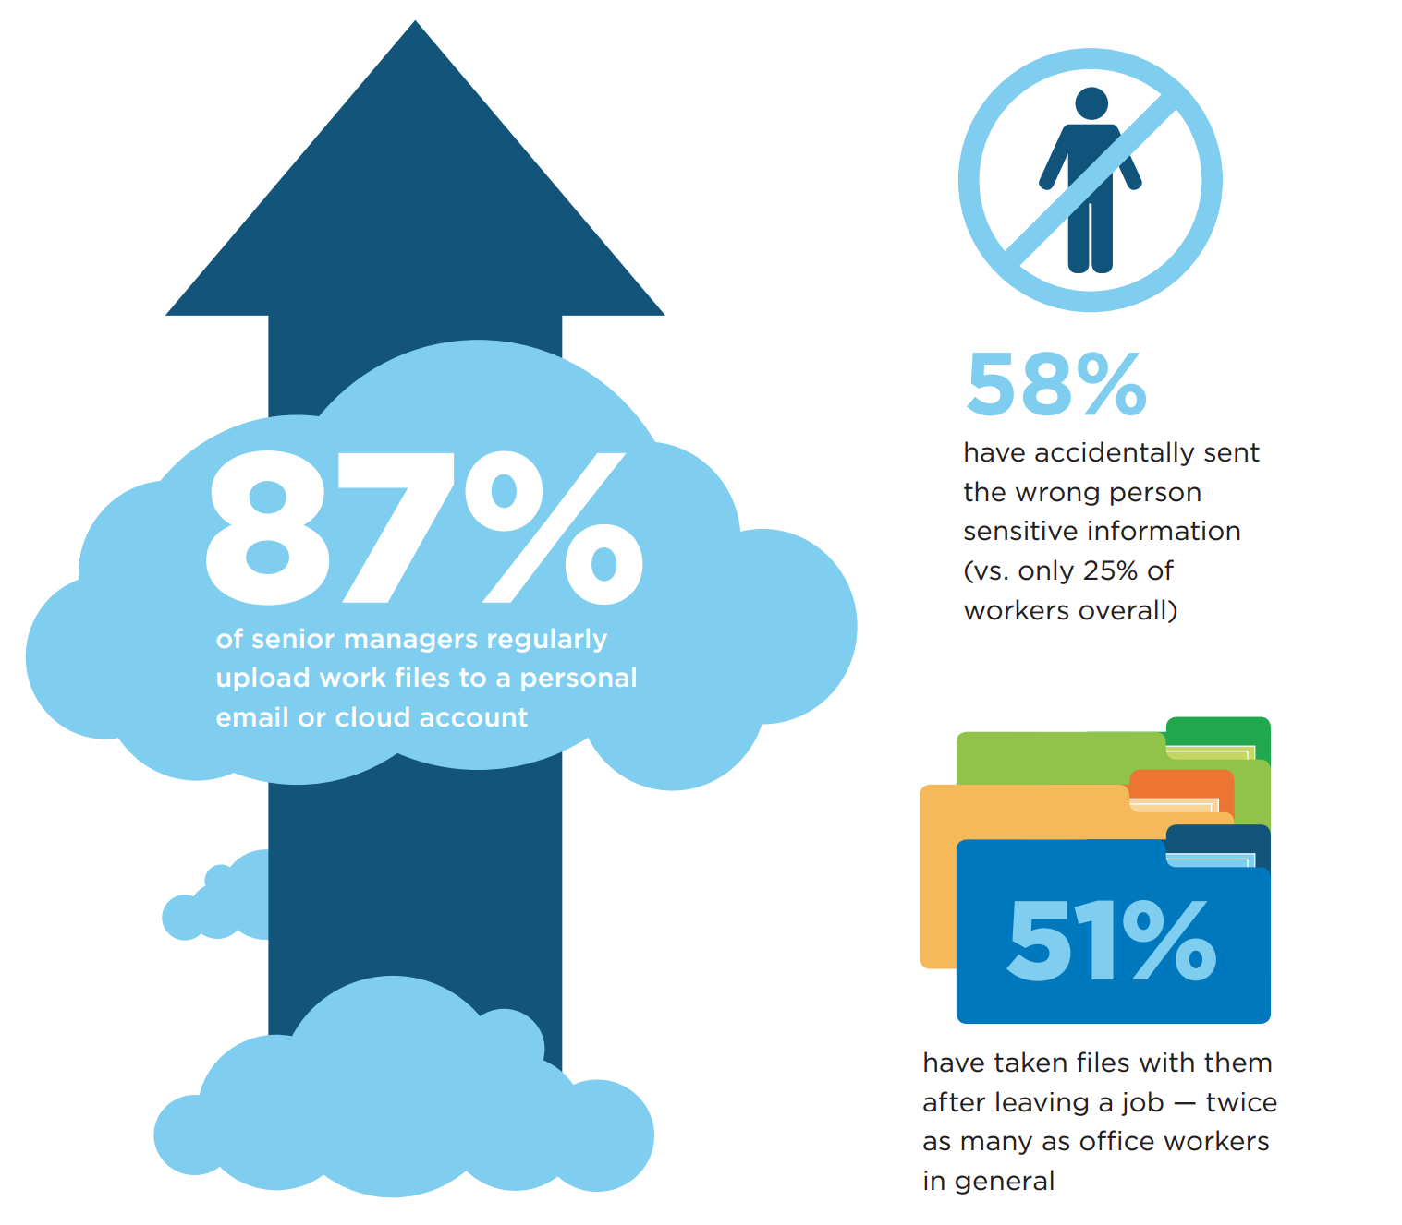
Collaboration Today
Modern Workforce - Digital Trends redefining how we work
Remote Working has increased 4x (1995-2015)
Information on-demand “overload” – Over 90% of world’s data generated over last 2 years
Information is being shared more freely by Senior Managers – personal email / public cloud file sharing on the rise
Employees prefer to work on 2X more teams now than they did 5 years ago
Millennial “Tech Savvy multi-tasker” Workforce – projected to be 50% of US workforce by 2020

Slide 10
Modern Tools

Slide 11
“Group based” Collaboration Need
Siloed Apps - Friction across applications – multiple logins, difficulty sharing and discovering information
Wasted Time - Context switching between different apps drains attention and time
Shadow IT - Incomplete toolset can lead to inconsistent security, compliance and risk
Mail & Calendar
Sites & Content Management
Co-Authoring Content
Voice, Video & Meetings
Enterprise Social
Chat-based Workspace

Slide 12
“Generational” Work Tools usage
 |  | Baby Boomer (1946-1964) | Generation X (1965-1979) | Millennial (1980-1997) | Generation Z (1998-2020)
 | In Person Meeting
 | Virtual Online Meeting (No Video)
 | Virtual Online Meeting (Video)
 | Email
 | Team Workspaces
 | Instant Message (IM)
 | Enterprise Social Networking
 | Persistent Chat
 | Conversational User Interfaces
Always prefer
Mostly prefer
Somewhat prefer
Occasionally prefer
Do not prefer

Slide 13
Office 365 Services for your Digital Needs
Office 365 Services - Designed for the unique workstyle of every group
End-End Collaboration Solution -
Office 365 addresses the breadth of collaboration needs across your company
Integrated Experiences - Office 365 Groups and Graph enable integrated experiences that facilitate effective collaboration
Security and Compliance - Office 365 delivers the security, compliance and manageability required by Digital Modern workplace
SharePoint
Outlook
Mail & Calendar
Sites & Content Management
Skype
Voice, Video & Meetings
Co-Authoring Content
Office 365 ProPlus
Enterprise Social
Teams
Yammer
Chat-based Workspace
Office 365 Groups

Slide 14
Office 365 – A Quick Recap
MAIL + CALENDAR
SHARING + COLLABORATION
ENTERPRISE SOCIAL
UNIVERSAL COMMUNICATION
MICROSOFT OFFICE
Exchange
Office
OneDrive For Business + SharePoint
Modern Collaboration
Skype for
Business
Office
365 ProPlus
100GB Mailboxes
150MB Attachments
Unlimited Storage per user in OneDrive
Office Delve- surface content from anywhere
IM, Presence, HD Calling
Office for iPad and Android
Encrypted E-Mail
Sync App
Office 365 Video Portal
Host video conferences for 250 people
Real Time Co-Authoring Across Platforms
Scalable Unlimited Archives
Data Loss Prevention
eDiscovery
Enterprise Social with Yammer
Skype Broadcasting for up to 10,000
Office Online (Browser)
eDiscovery
Legal Hold
DLP
Modern SharePoint Sites + Mobile App
Microsoft Teams (chat based workspace)
S4B for iPhone, Android and IPad
Office 2016 Mac + PC

Slide 15
What, When, How?

Slide 16
What? Establish Business Scenario
  To begin to form your own business scenarios, consider using the following framework:
My Roles…
[Team]
My Tasks…
[Description of what I want to do]
My Tools…
[Specific application of
the technology]
My Success...
[Solutions
success measure]
As someone in
Sales
I want to
have a single version
of the client proposal that
everyone can access and edit rather than emailing different versions around
the team
Using
a SharePoint site to
centrally store and share a single version of a
client proposal that my
team can edit together
using co-authoring
in Word and PowerPoint
I’ll know this is successful when
my sales team can create client proposals faster and therefore have more
time to close deals
Notes:
You might wonder how this all fits together. Usage scenarios like a specific process will map to a business scenario. The business scenarios align to the organization’s business strategy. Let’s take a look at another example.

Slide 17
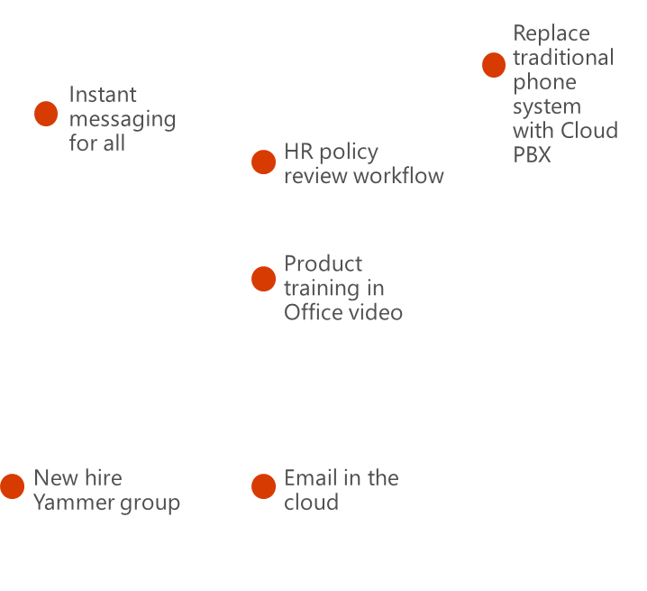
When? Prioritize Timings – “Quick Wins”
Plot your Business Scenarios - to understand what scenarios will provide the highest level of impact the fastest, and also help to determine the harder projects that may be more important, but need more planning.
Scenario positioning - will help determine the highest value scenarios to focus on first. High impact, low difficulty scenarios should be your first “quick wins.” Medium and high difficulty scenarios will require more stakeholder analysis and discussion.
High
Impact
Medium
Low
Low
Medium
High
Difficulty

Slide 18
How – Define Collaboration Journey
Yammer
Ideation
Harvests knowledge
Shares result
Skype for Business
Skype call with colleague
Presentation
of solution
SharePoint Sites
Formalized project
Searches for information
Persistent
Storage
Archival
Microsoft Teams
Refines solution
Collaborates with team
Office 365 Groups
Creates a Group and shares document
Finalizes result
OneDrive for Business
Creates a document
Outlook e-mail
Feedback from SMEs
Project Collaboration
Proposal Development
© Copyright Avanade 2016
Notes:
Collaboration is not always a static and pre-defined process and a Digital Workplace must accommodate for all scenarios.
Microsoft Teams supercharges collaboration: http://blog.avanade.com/avanade-insights/collaboration/microsoft-teams-supercharges-collaboration-for-millennials-to-boomers/

Slide 19
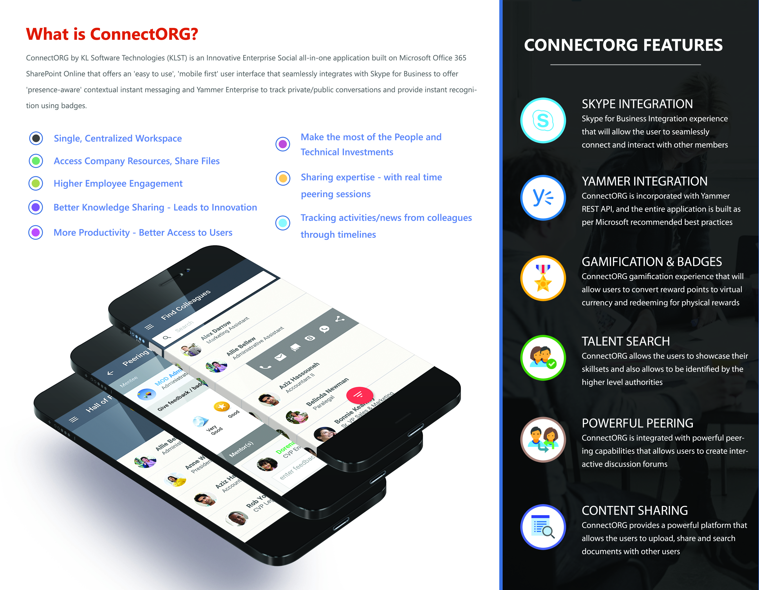
Demo
  Yammer, Groups, OneDrive for Business, Skype, Teams
  ConnectORG - www.klstinc.com/connectorg - Enterprise Social & Gamification

Slide 20
Demo: Ragav’s Journey
Yammer
Global request
Read response
Skype for Business
Talk to Tom
SharePoint Sites
Create Plan
Microsoft Teams
Create Team
Office 365 Groups
Team request
OneDrive for Business
Copy Document
Outlook e-mail
Grab Document
ConnectORG
Rewards, Badges

Slide 21
TODOs: Identify Collaboration Factors

Slide 22
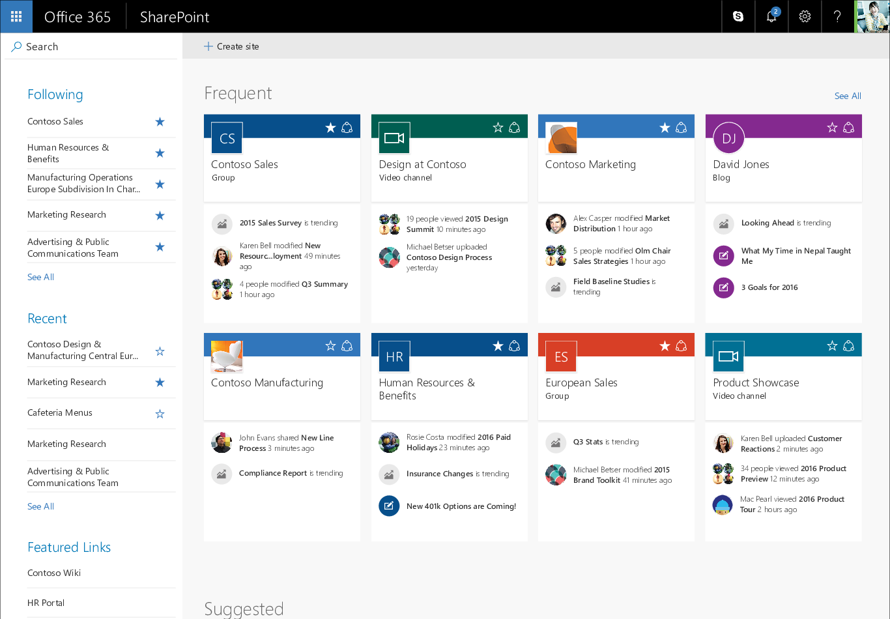
TODO 1: Determine the Audience
With whom do you need to communicate?
Yammer and Skype Broadcast works well for organization wide communication
SharePoint, Groups, Planner and Teams are beneficial for team and project collaboration
Outlook and Skype are ideal for one to one conversations

Slide 23
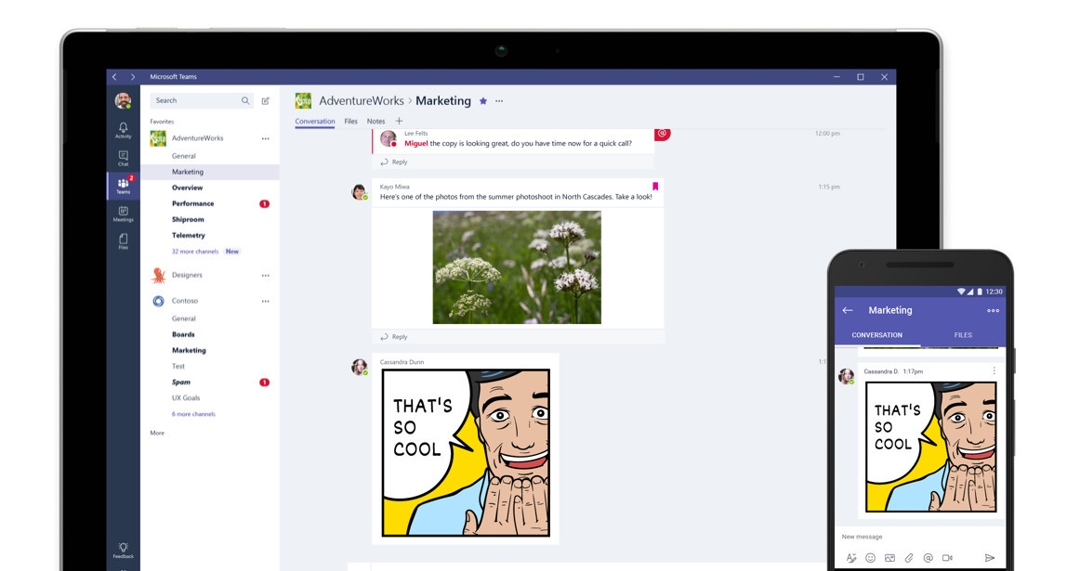
TODO 2: Define Time Sensitivity
How do you express yourself?
Outlook and SharePoint are common tools for formal communications and collaboration
Yammer, Planner, Groups and Teams supports informal communications and collaboration
Skype can support both formal and informal communications and collaboration

Slide 24
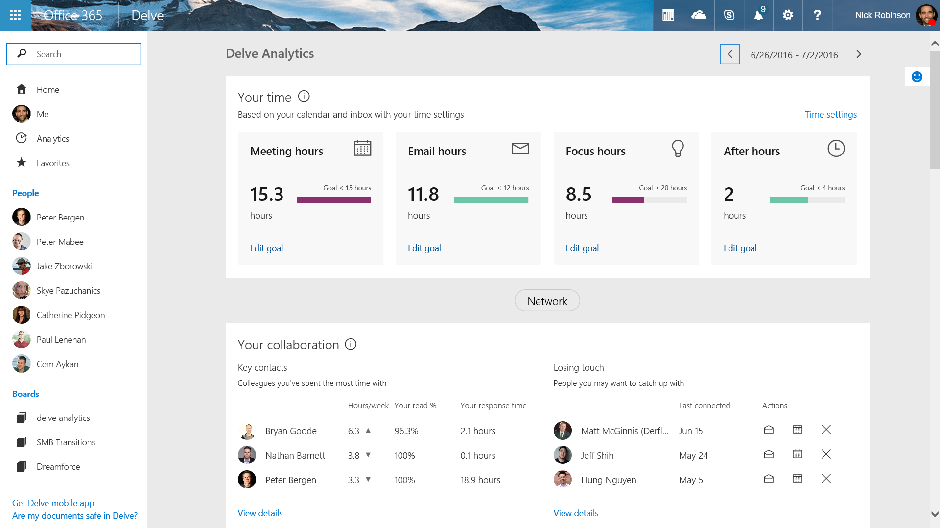
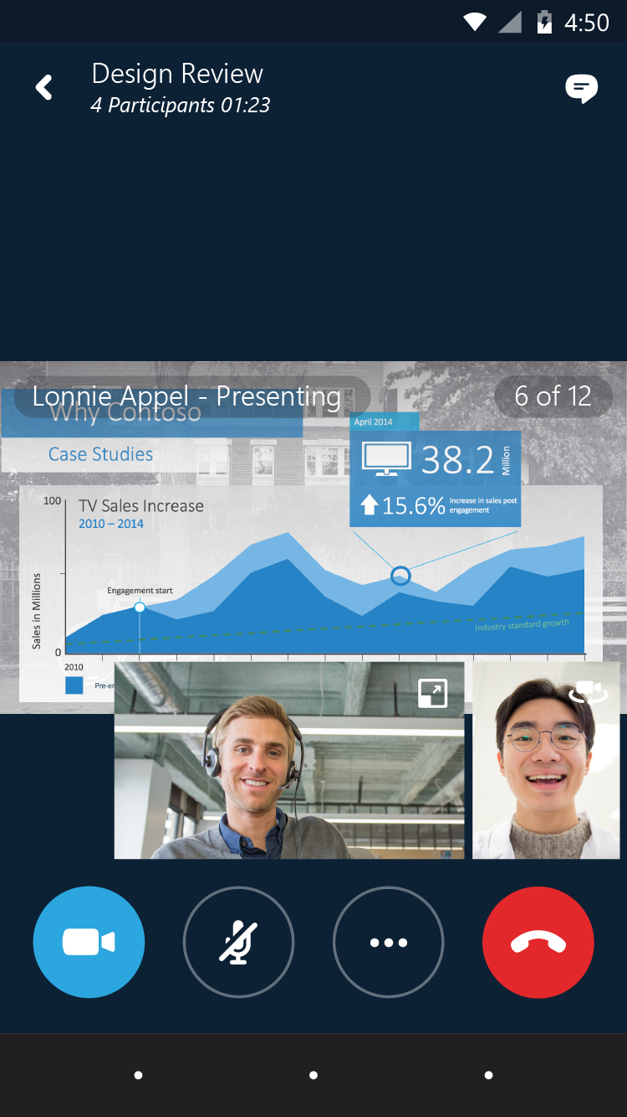
TODO 3: Define Collaboration Tones
How do you express yourself?
Outlook and SharePoint are common tools for formal communications and collaboration
Yammer, Planner, Groups and Teams supports informal communications and collaboration
Skype can support both formal and informal communications and collaboration

Slide 25
TODO 4: Define Organizational Roles
Who are you in the organization?
Pick your battles
Outlook is the de facto tool for senior leaders
All the other collaboration tools enables everyone else in the organization
Organizational roles dictate how they want to collaborate

Slide 26




In Summary
  Learn how to get the most out of Office 365, quickly get your team onboard, and drive adoption with FastTrack.
Business Scenarios – “Start Small”
  Scenarios inspire people to work in new ways using Office 365, along with related communication kits to support adoption. Great examples found in http://aka.ms/ProductivityLibrary.
  Approach – “Modern Tools”
  A three-step approach to drive adoption supported by modern “cloud based” tools on a common platform.
  Resources – “Find Champions”
  Helpful resources to learn about others’ success and social recognition driven search - http://www.klstinc.com/connectorg
  Community – “Reward Participation”
  Have a evolving Gamification Strategy as part of driving adoption community - http://www.klstinc.com/connectorg.
  fasttrack.office.com 

Slide 27

Thank You
  Twitter - @ragavj
  Skype – sip:ragav@klstinc.com
  LinkedIn – www.linkedin.com/in/ragav
  Blog – ragavj.blogspot.com
  Key Statistics References - http://bit.ly/DigitalWorkplaceStats

